Slide 1

PerformACE:
Employee Performance management
Tushar Zaware - 23107089
Aditya Sharma - 23107111
Dhanshri Shinde - 23107107
Konika Yadav - 22107006
Project Guide
Ms. Aavani Nair

Slide 2
Contents
Introduction
Objectives
Scope
Features / Functionality
Project Outcomes
Technology Stack
Block Diagram

Slide 3
1. Introduction
Problem Identified :
In today's fast-paced world, tracking the performance of individuals in a company or organization while managing multiple tasks is challenging and often inefficient due to scattered and unorganized data.
Solution Proposed :
We propose an application that functions as a comprehensive performance management tool.
It consolidates and tracks the complete data of all registered individuals, providing a centralized and organized view of performance metrics, making data access and evaluation seamless and efficient.

Slide 4
2. Objectives
To design a user-friendly graphical interface using Tkinter, which can be achieved by implementing simple, intuitive navigation, layout designs, and input forms for data collection using widgets like text fields, buttons, and drop-down menus.
To integrate data visualization capabilities using Matplotlib, which can be achieved by creating graphs and charts for easy performance analysis.
To automate event notifications and alerts, which can be achieved by setting timers and conditions within the system.
To integrate TkCalendar for scheduling and managing upcoming events, achievable by providing an interactive calendar view and event reminder system.

Slide 5
3. Scope
Can be applied in educational institutions for automating performance evaluations and progress monitoring of students and faculty.
Can be useful for event management teams by providing scheduling, calendar integration, and notification systems.
Can benefit project managers by offering data tracking, visualization, and benchmarking capabilities for various tasks and milestones.
Can be applied in small to medium businesses (SMBs) for performance reviews, data-driven decision-making, and operational analysis.
Can be extended to integrate advanced libraries and features, like AI recommendations and database systems for scalability.
Can provide valuable insights to teachers and mentors by visualizing learner progress and patterns in performance data.
Can help organizations in scheduling and managing events efficiently, including setting reminders and event alerts.

Slide 6
4. Feature /Functionality
User-Friendly Interface:
A simple and intuitive graphical user interface (GUI) built using Tkinter to facilitate easy navigation and interaction for users without technical expertise.
Data Visualization:
Integrates Matplotlib to generate charts and graphs, enabling clear and meaningful insights from performance data.
Automated Notifications:
Offers alerts and notifications for deadlines, events, and performance benchmarks to keep users informed and on track.
Report Generation:
Supports report creation in formats such as PDF and CSV, allowing users to document and analyze historical performance data.

Slide 7
5. Outcome of Project
Enhanced user experience through a user-friendly Tkinter graphical interface.
Efficient data visualization using Matplotlib for real-time charts and graphs.
Structured data collection and tracking through Tkinter input forms.
Automated event notifications and alerts for timely reminders.
Interactive scheduling and event management with TkCalendar integration.

Slide 8
5. Outcome of Project
Organization management capabilities for creating or joining teams.
Secure user authentication with login and signup features.
Improved time and resource efficiency through automation.
Better planning and scheduling with event reminders and calendar integration.
Data-driven insights for performance benchmarking and growth tracking.

Slide 9
6. Technology Stack
Front end (GUI) – TKinter(Python GUI Library)
Back end (Database) – MySQL 8.0 CE (SQL)

Slide 10
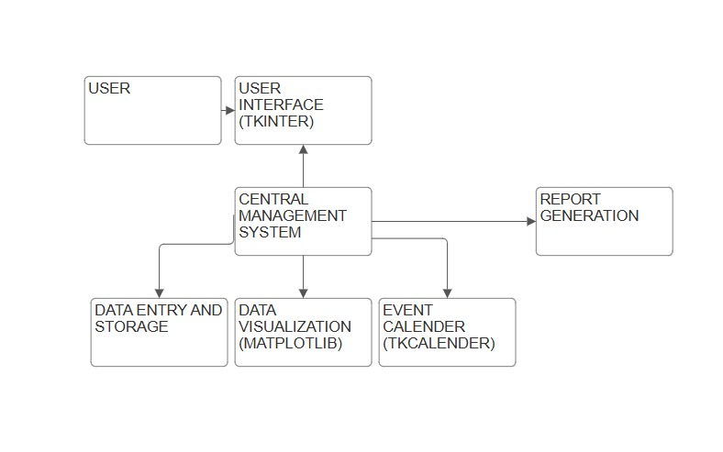
7. Block Diagram

Slide 11
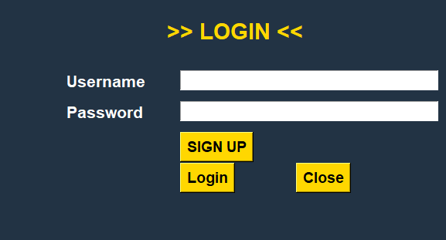
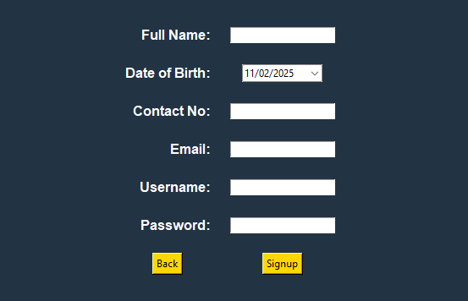
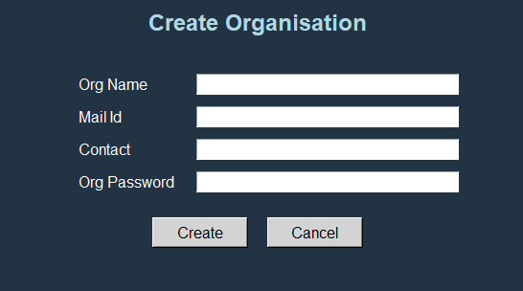
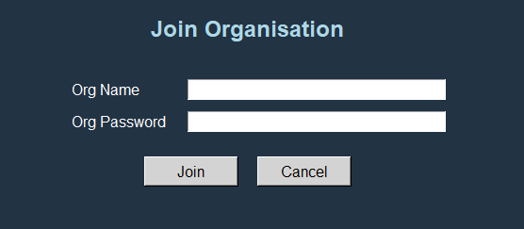
SCREENSHOTS

Slide 12
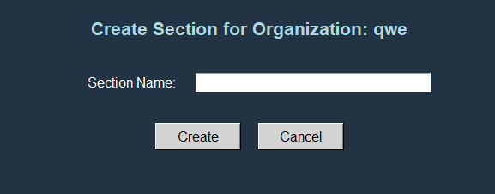
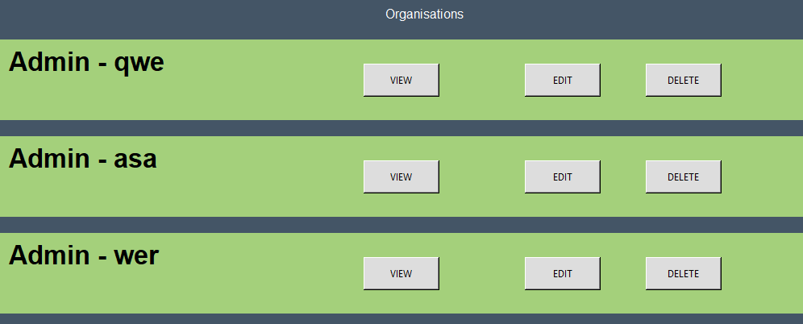
SCREENSHOTS

Slide 13
Thank You...!!

